Slide 1


Hanna Slavinska
06.02.2025

Slide 2

Outline
Executive Summary
Introduction
Methodology
Results
Conclusion
Appendix

Slide 3
Executive Summary
Summary of methodologies
Data Collection & Preprocessing
Data Wrangling
Exploratory data analysis with data visualization
Visual Analytic with Folium and Ploty Dash
Predictive Analysis
Summary of all results
Exploratory data analysis results
Interactive analytics demo in screenshots
Predictive analysis results

Slide 4
Introduction
SpaceX and the Need for Reusability. Space exploration is expensive, and rocket reusability is key to reducing costs. SpaceX Falcon 9 is one of the first rockets designed for multiple reuses, lowering launch expenses. Successful booster landings enable cost-efficient space missions and commercial space travel.
Data-Driven Decision Making. The project analyzes past Falcon 9 launches to identify key factors affecting booster landing success. Data science and machine learning are used to find patterns in launch outcomes. The findings help optimize future launches, increasing success rates and cost savings.
Why This Matters?
Commercial & Scientific Benefits: Lower costs make space more accessible for businesses and research.
Sustainability: Reusable rockets reduce space debris and material waste.
Competitive Advantage: Understanding key success factors helps SpaceX stay ahead of competitors.

Slide 5

Section 1

Slide 6
Methodology
Data used in this project were collected from SpaceX Rest API and from
Wikipedia launch table. The wrangling of the collected data included cleaning,
preparation for visualization and information extraction for usage in ML
predictive models such as logistic regression, support vector machine (SVM),
decision tree, and K-nearest neighbors (KNN).
In addition, exploratory data analysis (EDA) was performed using visualization
and SQL. Lastly, Folium and Plotly Dash Python libraries were use in data
representation and in the interactive visual analytics of the data.
Finally, predictive analysis was performed using classification models
for predicting if the first stage of Falcon 9 rocket will land successfully using
Skikit-learn and also the accuracy of the model was determined.

Slide 7
Data Collection
Data Sources:
Historical Falcon 9 launch data was collected from publicly available datasets, including SpaceX’s official records and third-party sources.
Additional data, such as weather conditions and geographic information, was integrated where applicable.
Data Cleaning & Preparation:
Removed missing values and inconsistencies.
Converted categorical variables (e.g., Launch Site, Booster Version, Orbit) into numerical features for modeling.
Created new features like marker colors to visualize success/failure rates.

Slide 8
Data Collection – SpaceX API
The process of collecting SpaceX launch data involves retrieving, processing, and organizing the data into a structured format for analysis.
This process ensures that the SpaceX launch data is collected, cleaned, and structured effectively for further analysis.
Data collection API notebook
1. Retrieve Data from the SpaceX API
2. Parsing and Structuring the JSON Data
3. Filtering and Cleaning the Data
4. Transforming and Restricting Data
5. Retrieving Additional Information from API
6. Creating the Final Structured Dataset

Slide 9
Data Collection - Scraping
The requests.get() method was used to send an HTTP GET request to the Wikipedia page containing Falcon 9 launch data.
The response was stored in a variable and converted into a BeautifulSoup object using BeautifulSoup (response.text, 'html.parser’).
The find_all() function was used on the BeautifulSoup object to locate all <table> elements on the page.
The table headers (<th> elements) were extracted using a loop, and a helper function (extract_column_from_header()) was applied to retrieve the column names.
A dictionary (launch_dict) was created using the extracted column names as keys.
Additional keys, such as "Version Booster," "Booster Landing," "Date," and "Time," were added to the dictionary to store more specific launch details.
A loop was used to iterate through all tables with the class "wikitable plainrowheaders collapsible".
The launch_dict dictionary was converted into a Pandas DataFrame using pd.DataFrame().
Data collection API notebook
1. Request the Wikipedia Page
2. Extract Column Names from Table Header
3. Create and Initialize Data Dictionary
4. Parse Table Rows and Extract Data
5.Convert Dictionary to DataFrame

Slide 10

Data Wrangling
The value_counts() method was applied to LaunchSite column to determine how many launches occurred at each site. The results showed that CCAFS SLC 40 had the highest number of launches, followed by KSC LC 39A and VAFB SLC 4E.
The value_counts() method was applied to Orbit column to count how many launches targeted each orbit type. The most common orbit was GTO (Geostationary Transfer Orbit), followed by ISS (International Space Station) and VLEO (Very Low Earth Orbit).
The value_counts() method was applied to count the different landing outcomes.
A binary classification variable (landing_class) was created to distinguish between successful and unsuccessful landings.
The new Class column was added to the dataset, allowing for easier analysis and model training in future steps.
Data collection API notebook
2. Counting the Occurrences of Each Orbit Type
4. Creating a Classification Label for Landing Outcomes
1. Calculating the Number of Launches per Site
3. Analyzing Landing Outcomes

Slide 11
EDA with Data Visualization
Flight Number vs. Payload Mass (Scatter Plot) to explore how flight experience and payload mass influence launch success.
Flight Number vs. Launch Site (Scatter Plot) to examine launch success patterns at different sites over time.
Payload Mass vs. Launch Site (Scatter Plot) to investigate if launch sites handle different payload capacities.
Success Rate by Orbit Type (Bar Chart) to compare orbit types based on successful landings.
Flight Number vs. Orbit Type (Scatter Plot) to determine if flight experience influences success for different orbits.
Payload Mass vs. Orbit Type (Scatter Plot) to check if heavier payloads affect success for different orbit types.
Yearly Success Rate Trend (Line Chart) to track SpaceX’s success rate over time.
Data collection API notebook

Slide 12
EDA with SQL
Summary of SQL Queries Performed
Retrieved unique launch site names.
Displayed 5 records where the launch site name starts with "CCA".
Calculated the total payload mass carried by boosters launched for NASA (CRS).
Calculated the average payload mass for the booster version "F9 v1.1".
Found the earliest date when a successful landing on a ground pad occurred.
Retrieved booster versions with successful drone ship landings and payload mass between 4000 and 6000 kg.
Counted the number of successful and failed mission outcomes.
Retrieved booster versions that carried the maximum payload mass using a subquery.
Listed failure landing outcomes on drone ships in 2015, including the month, booster version, and launch site.
Ranked landing outcome counts between June 4, 2010, and March 20, 2017, in descending order.
Data collection API notebook

Slide 13
Build an Interactive Map with Folium
Summary of Map Objects Added to the Folium Map
Marking Launch Sites with Folium Markers with site names and Folium Circles around each launch site for visibility. Reasoning: to provide a clear visual representation of all SpaceX launch sites and helps analyze geographic distribution and proximity to key features (e.g., coastlines).
Marking Success/Failure of Launches with Folium Green Markers for successful launches and Folium Red Markers for failed launches. Reasoning: to analyze the success rate of launches at different sites. Clustered markers make it easier to visualize trends without excessive overlap.
Distance Analysis & Proximity Features.
Mouse Position Tracker was added to determine coordinates of nearby features like coastlines, highways, and railways.
Folium Marker at the closest coastline point with a label displaying the distance from the launch site.
Folium PolyLine connecting the launch site to the closest coastline.
Reasoning: to analyze the proximity of launch sites to key geographic features. Important for understanding safety considerations and environmental factors.
Data collection API notebook

Slide 14
Build a Dashboard with Plotly Dash
Plots and Graphs
Pie Chart (Success Rate by Launch Site)
Displays the total successful launches per site when "All Sites" is selected.
Shows the breakdown of success vs. failure for a specific site when selected.
Scatter Plot (Payload vs. Success Rate)
Displays the correlation between payload mass and launch success.
Color-coded by booster version category.
Filters data based on the selected site and payload range.
Why These Plots and Interactions Were Added
Pie Chart: Helps users quickly visualize the success distribution across different launch sites.
Scatter Plot: Enables exploration of how payload mass affects launch success.
Dropdown: Provides an easy way to compare individual sites or analyze overall trends.
Range Slider: Allows users to explore how different payload ranges impact launch success rates.
Data collection API notebook

Slide 15
Predictive Analysis (Classification)
Data Preparation
• Extracted target variable (Y = data['Class'].to_numpy())
• Standardized feature variables using StandardScaler (X = transform.fit_transform(X))
• Split data into training and testing sets (train_test_split(X, Y, test_size=0.2, random_state=2))
Model Selection & Hyperparameter Tuning
Logistic Regression used GridSearchCV with parameter tuning (C, penalty, solver). Best parameters: {'C': 0.01, 'penalty': 'l2', 'solver': 'lbfgs’}
Support Vector Machine (SVM) tuned hyperparameters (kernel, C, gamma) using GridSearchCV. Best parameters: {'C': 1.0, 'gamma': 0.0316, 'kernel': 'sigmoid'}
Decision Tree tuned criterion, splitter, max_depth, max_features, min_samples_leaf, min_samples_split. Best parameters: {'criterion': 'entropy', 'max_depth': 12, 'max_features': 'sqrt', 'min_samples_leaf': 2, 'min_samples_split': 10, 'splitter': 'random'}
K-Nearest Neighbors (KNN) tuned n_neighbors, algorithm, p. Best parameters: {'algorithm': 'auto', 'n_neighbors': 10, 'p': 1}

Slide 16
Predictive Analysis (Classification)
Model Evaluation & Selection
Used accuracy scores and confusion matrices to evaluate models
Noted false positives as a key issue in classification
Decision Tree achieved the highest test accuracy (0.8889) and was the best-performing model
Data collection API notebook

Slide 17

Section 2

Slide 18
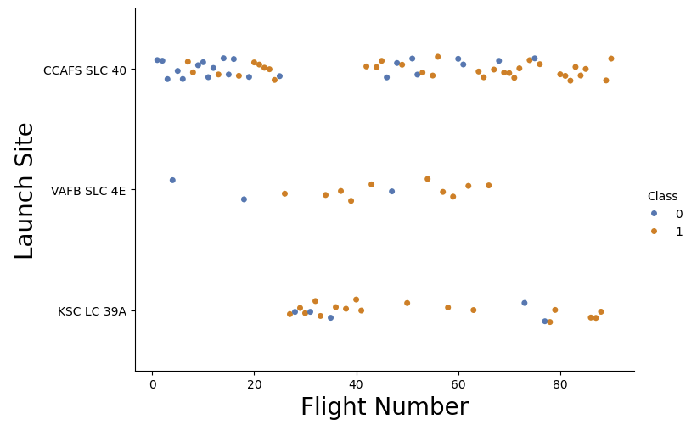
Flight Number vs. Launch Site
The plot shows three distinct launch sites:
CCAFS SLC 40 (Cape Canaveral Air Force Station Space Launch Complex 40)
VAFB SLC 4E (Vandenberg Air Force Base Space Launch Complex 4E)
KSC LC 39A (Kennedy Space Center Launch Complex 39A)
Site-specific Success Patterns:
CCAFS SLC 40: Shows a clear progression from mixed success/failure to more consistent successful landings in later flights
VAFB SLC 4E: Initially had some unsuccessful landings, but later flights show more successful landings
KSC LC 39A: Generally shows good landing success rates, particularly in later flights
Learning Curve Visible:
The transition from more blue dots (unsuccessful) to more orange dots (successful) across increasing flight numbers demonstrates SpaceX's learning curve in perfecting their landing technology
This progression is particularly visible in the CCAFS SLC 40 launches
Success Rate by Location:
KSC LC 39A appears to have a relatively high success rate
CCAFS SLC 40 shows the most complete evolution from mixed success to consistent successful landings
VAFB SLC 4E, despite fewer launches, also shows improvement in landing success over time
This data visualization effectively shows SpaceX's improvement in landing technology and success rates across different launch sites over time, with a clear trend toward more consistent successful landings in later flights.

Slide 19
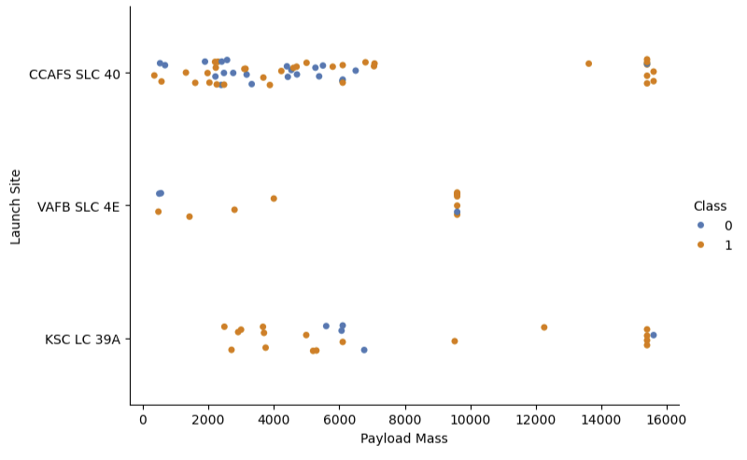
Payload vs. Launch Site
Payload Distribution by Launch Site:
CCAFS SLC 40: Handles a wide range of payload masses, concentrated between 2000-6000 mass units, with some launches around 15000
VAFB SLC 4E: Appears to handle lower to mid-range payloads, with a cluster around 9000 mass units
KSC LC 39A: Shows capability across various payload masses, from around 3000 to 15000 mass units
Landing Success Patterns:
Lighter payloads (2000-6000 mass units) show a mix of successful and unsuccessful landings across all sites
Heavier payloads (>10000 mass units) tend to show more successful landings (orange dots), particularly at CCAFS SLC 40 and KSC LC 39A
VAFB SLC 4E shows mixed success rates with its limited number of launches
Site Specialization:
CCAFS SLC 40 appears to be the most versatile site, handling the widest range of payload masses
VAFB SLC 4E seems more specialized for specific payload ranges
KSC LC 39A shows capability for both medium and heavy payloads
Success Rate vs Payload Mass:
There's no clear correlation between payload mass and landing success/failure
Successful landings have been achieved across the entire range of payload masses
Each launch site has demonstrated the ability to handle successful landings with their typical payload ranges
This scatter plot shows the relationship between Payload Mass and Launch Sites, with landing success (Class 1) and failure (Class 0) indicated by orange and blue dots respectively
This visualization helps understand how different launch sites are utilized for various payload masses and their respective landing success rates.

Slide 20
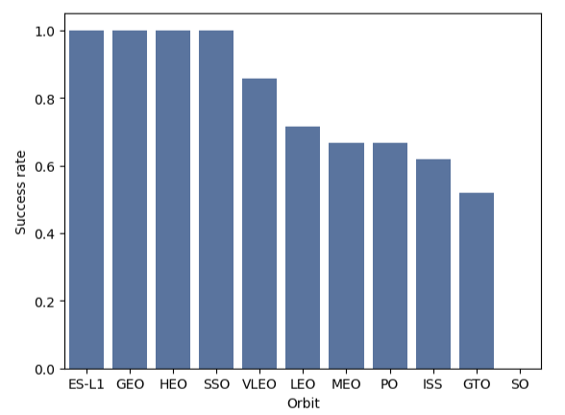
Success Rate vs. Orbit Type
Highest Success Rates (100%):
ES-L1 (Earth-Sun Lagrange Point 1)
GEO (Geostationary Earth Orbit)
HEO (Highly Elliptical Orbit)
SSO (Sun-Synchronous Orbit) These orbits have achieved perfect landing success rates.
High Success Rates (70-90%):
VLEO (Very Low Earth Orbit) shows about 85% success rate
LEO (Low Earth Orbit) shows approximately 70% success rate
MEO (Medium Earth Orbit) and PO (Polar Orbit) both show success rates around 65-70%
Lower Success Rates (50-65%):
ISS (International Space Station orbit) shows about 62% success rate
GTO (Geosynchronous Transfer Orbit) has the lowest success rate at around 52%
Key Observations:
Higher orbits generally show lower success rates, likely due to the increased fuel requirements and mission complexity
Orbits commonly used for satellite deployment (SSO, VLEO) show very good success rates
GTO missions, which require more energy to reach higher altitudes, show the lowest success rates
Special mission orbits like ES-L1 show perfect success rates, though these may represent fewer attempts
This bar chart shows the success rate of rocket landings for different orbit types in SpaceX missions.
This data suggests that orbit type and altitude play significant roles in landing success, with lower and specialized orbits generally achieving better landing success rates than higher energy orbits like GTO.

Slide 21
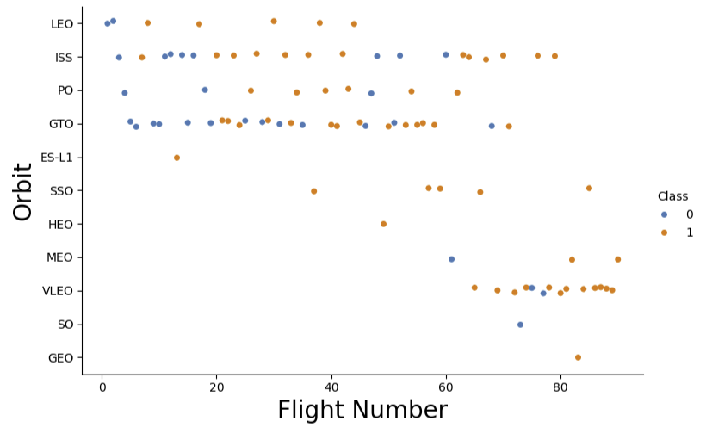
Flight Number vs. Orbit Type
Evolution of Orbit Types Over Time:
Early flights (lower flight numbers) focused mainly on LEO, ISS, and GTO missions
Later flights show greater diversity in orbit types, including VLEO, MEO, and SSO
The most recent flights (highest flight numbers) show a concentration of VLEO missions
Success Patterns by Orbit:
LEO: Early missions show mixed success, with more failures at the beginning
ISS: Consistent presence throughout flight history with mixed success rates
GTO: Shows mixed success throughout, with launches spread across flight numbers
VLEO: Predominantly successful landings in later flights
SSO: Sporadic but mostly successful missions in later flight numbers
ES-L1, HEO, and GEO: Limited number of missions, appearing later in the flight history
Learning Curve:
Earlier flights (0-20) show more blue dots (failures) across different orbits
Middle-range flights (20-60) show a mix of successes and failures
Later flights (60+) show predominantly orange dots (successes), suggesting improved landing capabilities across orbit types
Mission Diversity:
The range of orbit types has expanded as SpaceX has gained experience
Some orbit types (like VLEO) have become more common in recent flights
Certain orbits (like GEO and ES-L1) appear to be less frequent special-purpose missions
This scatter plot shows the relationship between Flight Numbers and Orbit Types, with landing success (Class 1 in orange) and failure (Class 0 in blue).
This visualization effectively shows both the evolution of SpaceX's capabilities across different orbit types and their improving success rates over time.

Slide 22
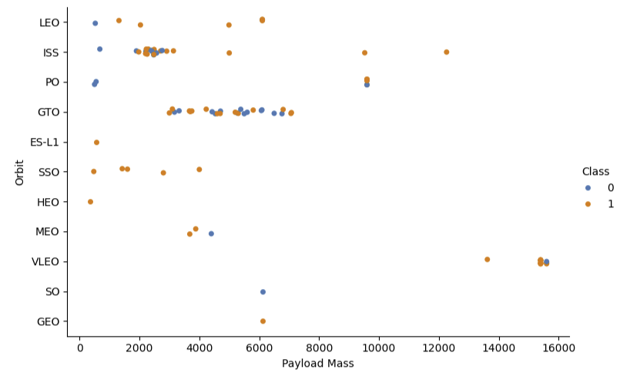
Payload vs. Orbit Type
Payload Mass Distribution by Orbit:
LEO (Low Earth Orbit): Relatively light payloads, mostly under 5000 mass units
ISS: Clustered around 2000-3000 mass units, showing consistency in cargo missions
GTO (Geosynchronous Transfer Orbit): Mid-range payloads, 4000-8000 mass units
VLEO (Very Low Earth Orbit): Heavier payloads around 15000 mass units
PO (Polar Orbit): Mix of payload masses, with concentration around 9000-10000 units
Specialized Orbits:
ES-L1: Very light payload (around 1000 mass units)
SSO (Sun-Synchronous Orbit): Light to medium payloads, 1000-6000 mass units
HEO (Highly Elliptical Orbit): Light payload missions
GEO: Single mission with medium payload mass around 6000 units
Landing Success Patterns:
Light payloads (<5000 mass units) show generally good success rates across orbits
Medium payloads (5000-10000) show mixed success, particularly in GTO missions
Heavy payloads (>10000) in VLEO show mostly successful landings with few failures
Mission Characteristics:
Different orbits clearly have different typical payload mass ranges
ISS missions show very consistent payload masses, likely due to standardized cargo requirements
GTO missions handle a wider range of payload masses with varied success rates
Heavier payloads are predominantly associated with VLEO missions
This scatter plot shows the relationship between Payload Mass and Orbit Types, with landing success (Class 1 in orange) and failure (Class 0 in blue)
This visualization helps understand how payload mass varies by orbit type and its potential impact on landing success rates.

Slide 23
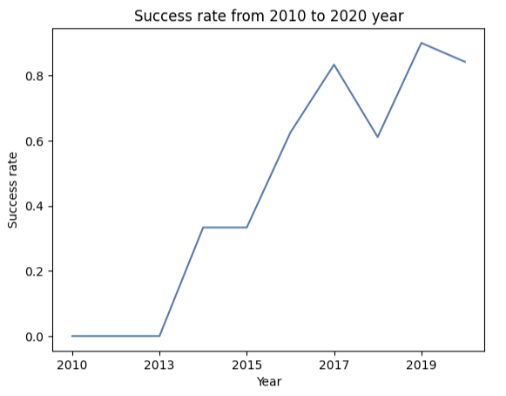
Launch Success Yearly Trend
Early Years (2010-2013):
2010-2013: Near 0% success rate. No successful landings were achieved during this period
Experimental phase when SpaceX was first developing their landing technology
Initial Breakthrough (2013-2015):
Sharp increase from 0% to about 30-35% success rate
This jump likely represents the first successful landing attempts
Success rate plateaued around 2015, suggesting a period of learning and refinement
Rapid Improvement (2015-2017):
Dramatic increase from 35% to over 80% success rate
This period shows the most significant improvement in landing technology
Reflects major technological breakthroughs and learning from previous attempts
Maturation Period (2017-2020):
Some fluctuation but generally high success rates. Notable dip to about 60% in 2018
Recovery to peak performance around 2019 (~90% success rate)
Slight decrease in 2020 but still maintaining above 80% success rate
Overall Trend:
Clear progression from experimental phase to reliable technology
Success rate improved from 0% to consistently above 80%
The curve shows classic technology adoption and refinement pattern:
Initial experimentation
Breakthrough
Rapid improvement
Stabilization at high performance levels
This line chart shows SpaceX's landing success rate evolution from 2010 to 2020.
This visualization effectively demonstrates SpaceX's remarkable progress in developing and perfecting their rocket landing technology over a decade.

Slide 24
All Launch Site Names
Present your query result with a short explanation here
There are 4 unique launch sites used in SpaceX missions:
CCAFS LC-40
VAFB SLC-4E
KSC LC-39A
CCAFS SLC-40
However, I notice that CCAFS LC-40 and CCAFS SLC-40 appear to be the same launch site with slightly different naming conventions (LC vs SLC for Space Launch Complex). So effectively, there are really 3 main launch sites that SpaceX has used for their missions:
Cape Canaveral Air Force Station (CCAFS) SLC-40 in Florida
Vandenberg Air Force Base (VAFB) SLC-4E in California
Kennedy Space Center (KSC) LC-39A in Florida
The query correctly used DISTINCT to eliminate duplicate entries, though it shows the naming inconsistency in the database for the CCAFS site.
%%sql SELECT DISTINCT "Launch_Site" FROM SPACEXTABLE
Launch_Site:
CCAFS LC-40
VAFB SLC-4E
KSC LC-39A
CCAFS SLC-40

Slide 25
Launch Site Names Begin with 'CCA'
5 records for launch sites begin with the string 'CCA’ and the query used for obtaining the information is shown below.
%%sql SELECT * FROM SPACEXTABLE
WHERE "Launch_Site" LIKE 'CCA%’
LIMIT 5
Date | Time (UTC) | Booster_Version | Launch_Site | Payload | PAYLOAD_MASS__KG_ | Orbit | Customer | Mission_Outcome | Landing_Outcome
2010-06-04 | 18:45:00 | F9 v1.0 B0003 | CCAFS LC-40 | Dragon Spacecraft Qualification Unit | 0 | LEO | SpaceX | Success | Failure (parachute)
2010-12-08 | 15:43:00 | F9 v1.0 B0004 | CCAFS LC-40 | Dragon demo flight C1, two CubeSats, barrel of Brouere cheese | 0 | LEO (ISS) | NASA (COTS) NRO | Success | Failure (parachute)
2012-05-22 | 7:44:00 | F9 v1.0 B0005 | CCAFS LC-40 | Dragon demo flight C2 | 525 | LEO (ISS) | NASA (COTS) | Success | No attempt
2012-10-08 | 0:35:00 | F9 v1.0 B0006 | CCAFS LC-40 | SpaceX CRS-1 | 500 | LEO (ISS) | NASA (CRS) | Success | No attempt
2013-03-01 | 15:10:00 | F9 v1.0 B0007 | CCAFS LC-40 | SpaceX CRS-2 | 677 | LEO (ISS) | NASA (CRS) | Success | No attempt

Slide 26
Total Payload Mass
The SQL query calculates the total payload mass for all NASA Commercial Resupply Service (CRS) missions launched by SpaceX. The result shows that the total payload mass is 45,596 kg.
This indicates that SpaceX has transported over 45.5 metric tons of cargo for NASA's CRS missions, which primarily involve resupplying the International Space Station. The query achieves this by:
Using SUM() to add up all payload masses
Filtering specifically for "NASA (CRS)" missions using the WHERE clause
Measuring the mass in kilograms (KG)
This significant total mass demonstrates SpaceX's substantial contribution to NASA's space station resupply program over multiple missions.
%%sql SELECT SUM(PAYLOAD_MASS__KG_)
FROM SPACEXTABLE
WHERE "Customer"="NASA (CRS)"
SUM(PAYLOAD_MASS__KG_)
45596

Slide 27
Average Payload Mass by F9 v1.1
The SQL query calculates the average payload mass carried specifically by the Falcon 9 v1.1 booster version. The result shows that this version of the booster carried an average payload mass of 2,928.4 kg per mission.
This indicates that:
The F9 v1.1 booster was designed for medium-weight payloads
Each mission with this booster version typically carried around 3 metric tons of cargo
The query uses AVG() to calculate the mean payload mass across all F9 v1.1 missions
The WHERE clause filters specifically for the "F9 v1.1" booster version
This average payload capacity helps us understand the capabilities of this specific iteration of the Falcon 9 rocket series.
%%sql SELECT AVG("PAYLOAD_MASS__KG_")
FROM SPACEXTABLE
WHERE "Booster_Version"="F9 v1.1"
AVG("PAYLOAD_MASS__KG_") 2928.4

Slide 28
First Successful Ground Landing Date
The SQL query calculates the average payload mass carried specifically by the Falcon 9 v1.1 booster version. The result shows that this version of the booster carried an average payload mass of 2,928.4 kg per mission.
Then, using the MIN() function to find the earliest date, it shows that SpaceX achieved its first successful ground pad landing on December 22, 2015 (2015-12-22).
This was a historic milestone for SpaceX, as it marked their first successful landing on solid ground, demonstrating the capability to recover and reuse rockets by landing them vertically on a landing pad at Cape Canaveral - a key advancement in their goal of developing reusable rockets to reduce space launch costs.
%%sql SELECT DISTINCT "Landing_Outcome“
FROM SPACEXTABLE
Landing_Outcome:
Failure (parachute)
No attempt
Uncontrolled (ocean)
Controlled (ocean)
Failure (drone ship)
Precluded (drone ship)
Success (ground pad)
Success (drone ship)
Success
Failure
No attempt
%%sql SELECT min("Date")
FROM SPACEXTABLE
WHERE "Landing_Outcome"="Success (ground pad)"
min("Date") 2015-12-22

Slide 29
Successful Drone Ship Landing with Payload between 4000 and 6000
The SQL query identifies Falcon 9 booster versions that meet two specific criteria:
Successfully landed on a drone ship
Carried payloads between 4000 kg and 6000 kg
Some notable observations:
All these boosters are of the Falcon 9 "FT" (Full Thrust) version
Two of the boosters (.2 suffix) were used for second missions, showing successful reuse
These missions represent medium-weight payloads for the Falcon 9 capability range
The successful drone ship landings demonstrate SpaceX's ability to recover boosters at sea for this payload range
This data suggests that SpaceX has consistently achieved drone ship landings with medium-weight payloads using their Full Thrust variant of the Falcon 9.
%%sql SELECT "Booster_Version“
FROM SPACEXTABLE
WHERE "Landing_Outcome"="Success (drone ship)“
AND "PAYLOAD_MASS__KG_" BETWEEN 4000 AND 6000
Booster_Version
F9 FT B1022
F9 FT B1026
F9 FT B1021.2
F9 FT B1031.2

Slide 30
Total Number of Successful and Failure Mission Outcomes
The total mission count is 101, with an impressive success rate of about 99% (100/101 missions). This shows SpaceX's high reliability in achieving mission objectives, even before they mastered the landing technology. It's worth noting that mission success (delivering payload) is separate from landing success, as shown in the early missions where payloads were delivered successfully despite landing failures.
Mission outcome statistics:
Successful missions: 100 total (98 + 1 + 1 across different success categories)
98 standard successes
1 additional success
1 success with unclear payload status
Failed missions: 1 (failure in flight)
%%sql SELECT "Mission_Outcome", Count(*)
FROM SPACEXTABLE
GROUP BY "Mission_Outcome"
Mission_Outcome
Failure (in flight) - 1
Success - 98
Success - 1
Success (payload status unclear) - 1

Slide 31
Boosters Carried Maximum Payload
The SQL query uses a subquery to find all Falcon 9 boosters that have carried the maximum payload mass. The results show 12 different booster versions:
Key observations:
All boosters are Block 5 (B5) versions of Falcon 9
Many boosters have flown multiple times (indicated by the number after the decimal)
The range of reuse spans from 2 flights (B1060.2) to 7 flights (B1049.7)
These boosters all carried the same maximum payload mass
The numbering system (B10xx) suggests these are from a similar production period
This data demonstrates SpaceX's success in reusing Block 5 boosters for maximum payload missions multiple times.
%%sql SELECT "Booster_Version“ FROM SPACEXTABLE
WHERE "PAYLOAD_MASS__KG_“ = (SELECT max("PAYLOAD_MASS__KG_") FROM SPACEXTABLE)
Booster_Version: F9 B5 B1048.4, F9 B5 B1049.4, F9 B5 B1051.3, F9 B5 B1056.4, F9 B5 B1048.5, F9 B5 B1051.4, F9 B5 B1049.5, F9 B5 B1060.2, F9 B5 B1058.3, F9 B5 B1051.6, F9 B5 B1060.3, F9 B5 B1049.7

Slide 32
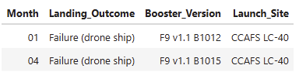
2015 Launch Records
The SQL query shows failed drone ship landing attempts during 2015, using substr() to extract both the month and year from the date field. The results show:
Key observations:
Both failures occurred with the v1.1 version of Falcon 9
Both launches were from the same site (CCAFS LC-40)
These represent early attempts at drone ship landings
Only two failed drone ship landing attempts were recorded in 2015
This data captures part of SpaceX's learning period as they were developing their drone ship landing capabilities.
%%sql SELECT substr(Date, 6,2) as "Month",
"Landing_Outcome", "Booster_Version", "Launch_Site“
FROM SPACEXTABLE
WHERE "Landing_Outcome" = 'Failure (drone ship)’
and substr(Date,0,5)='2015'

Slide 33
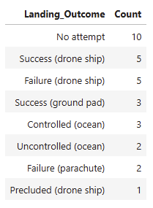
Rank Landing Outcomes Between 2010-06-04 and 2017-03-20
The SQL query ranks the frequency of different landing outcomes between June 4, 2010, and March 20, 2017. Here are the results in descending order:
Key observations:
Most early missions (10) had no landing attempts, showing SpaceX's gradual implementation of landing technology
Drone ship landings were the most attempted method (11 total: 5 successes, 5 failures, 1 precluded)
Ground pad landings had a good success rate (3 successful attempts)
Early parachute landing attempts (2) were unsuccessful
Ocean landings show evolution of control (3 controlled vs 2 uncontrolled)
This data illustrates SpaceX's progression from no landing attempts through various experimental methods to successful landings on both drone ships and ground pads.
%%sql SELECT "Landing_Outcome", count(*) as "Count“
FROM SPACEXTABLE
WHERE "Date" BETWEEN '2010-06-04' AND '2017-03-20’
GROUP BY "Landing_Outcome“
ORDER BY "Count" DESC

Slide 34

Section 3

Slide 35
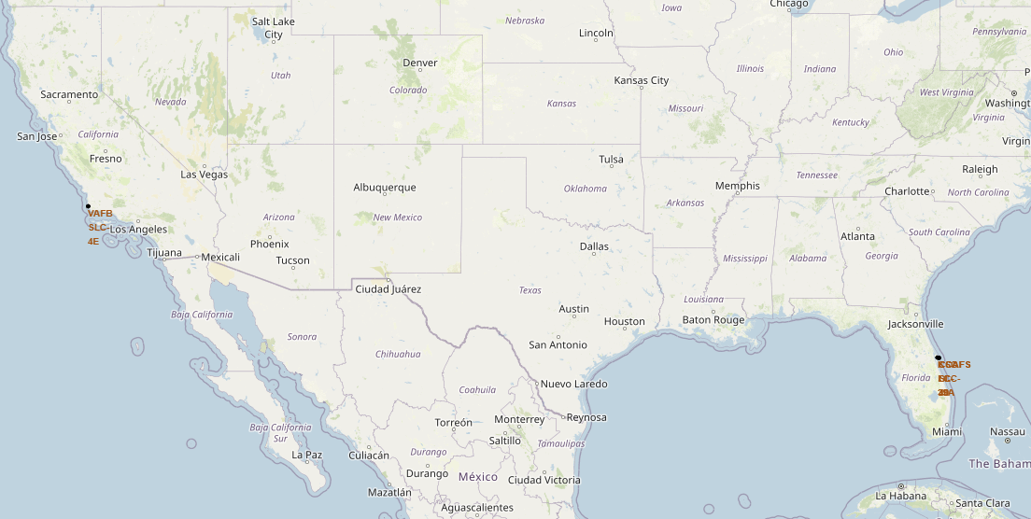
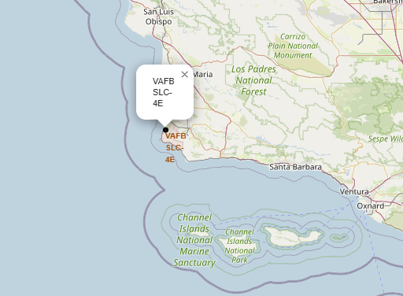
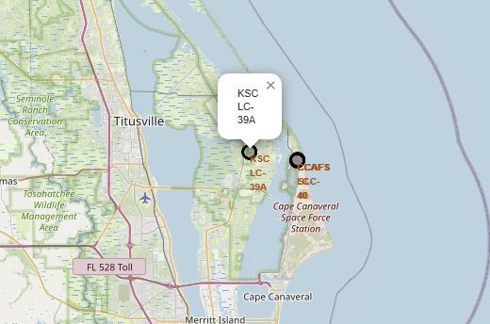
All launch sites on map
Most of Launch sites considered in this project are in proximity to the Equator line. Launch sites are made at the closest point possible to Equator line, because anything on the surface of the Earth at the equator is already moving at the maximum speed (1670 kilometers per hour)
All launch sites considered in this project are in very close proximity to the coast While starting rockets towards the ocean we minimize the risk of having any debris dropping or exploding near People.

Slide 36
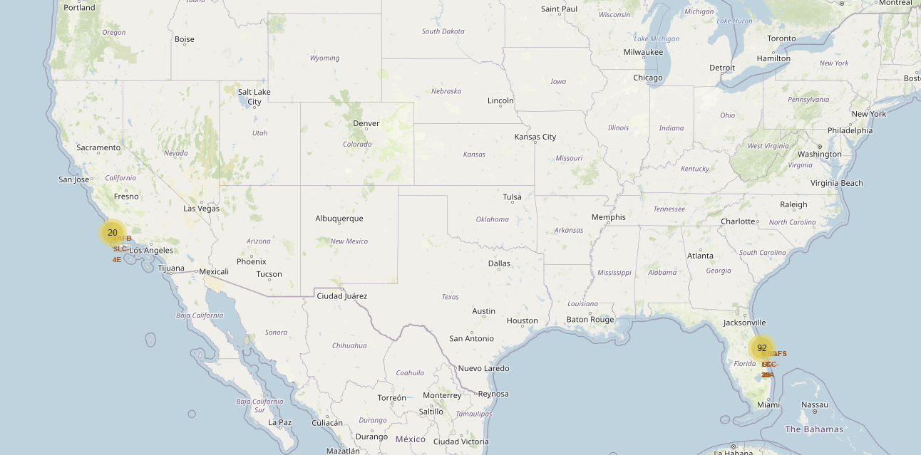
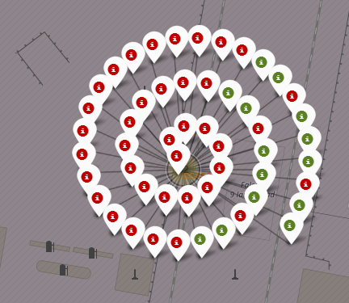
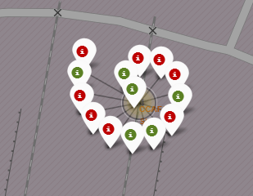
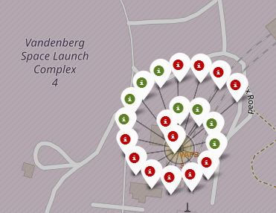
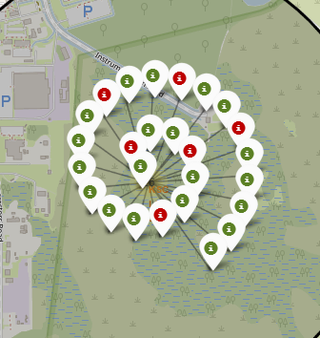
Success/Failed launches for each site
Launches have been grouped into clusters, and annotated with green icons for successful launches, and red icons for failed launches.

Slide 37
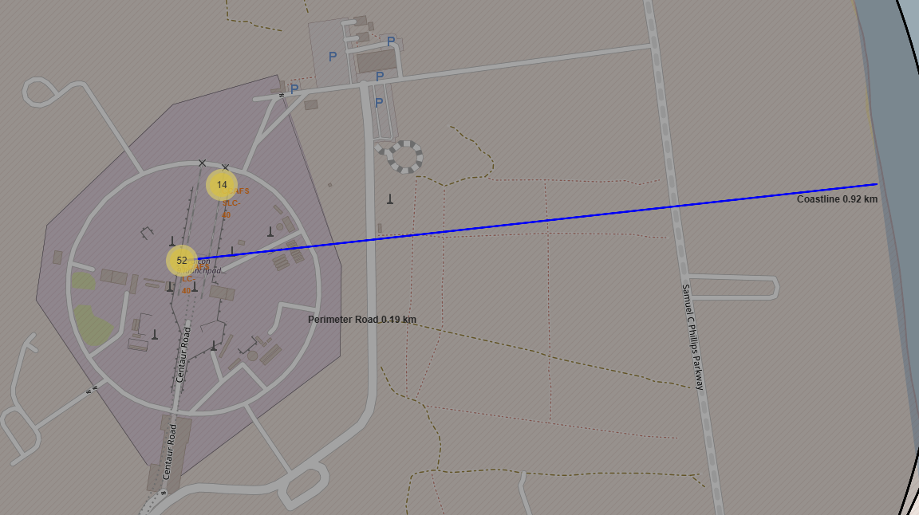
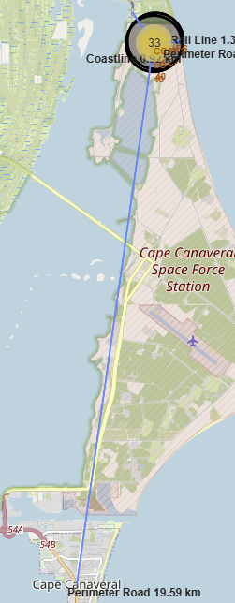
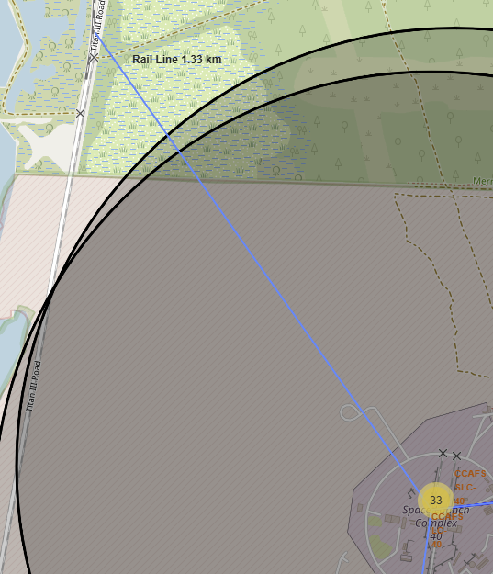
Proximity of Launch sites to other point of interest
Proximity of Launch site CCAFS SLC-40 to highway, railway, city and coastline were chosen to balance:
Launch safety requirements
Logistical accessibility
Different orbital trajectory needs
Population safety considerations
Access to skilled workforce

Slide 38

Section 4

Slide 39
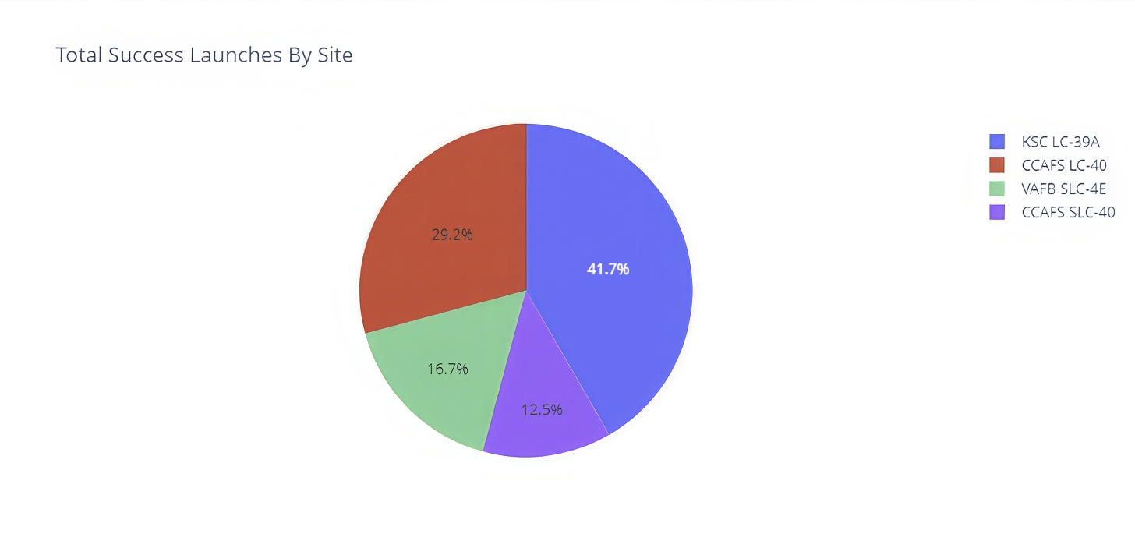
Launch success count for all sites
This pie chart shows the distribution of successful launches across SpaceX's different launch sites
Key findings:
Florida launch sites (KSC and CCAFS combined) account for over 83% of successful launches
Kennedy Space Center's LC-39A is clearly the most successful individual launch site
Vandenberg, while having fewer launches, plays a crucial role for specific orbit types
The data suggests SpaceX has achieved significant success rates across all their launch facilities

Slide 40
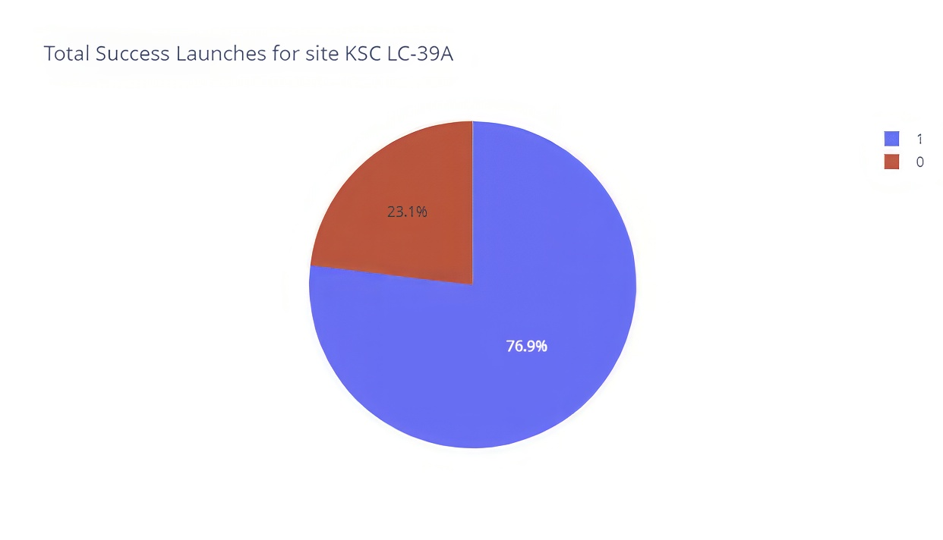
Launch site with highest launch success ratio
This pie chart shows the success rate of launches specifically at the Kennedy Space Center's Launch Complex 39A (KSC LC-39A)
Key findings:
KSC LC-39A has a very high success rate at over three-quarters of all launches
Only about one in four launches failed at this site
The success rate of 76.9% indicates this is one of SpaceX's most reliable launch facilities
The relatively low failure rate (23.1%) suggests good operational procedures and launch conditions at this site
This data demonstrates that KSC LC-39A is one of SpaceX's most reliable launch sites, with a significant majority of launches achieving their mission objectives. This high success rate likely influenced SpaceX's decision to make this site one of their primary launch facilities.

Slide 41
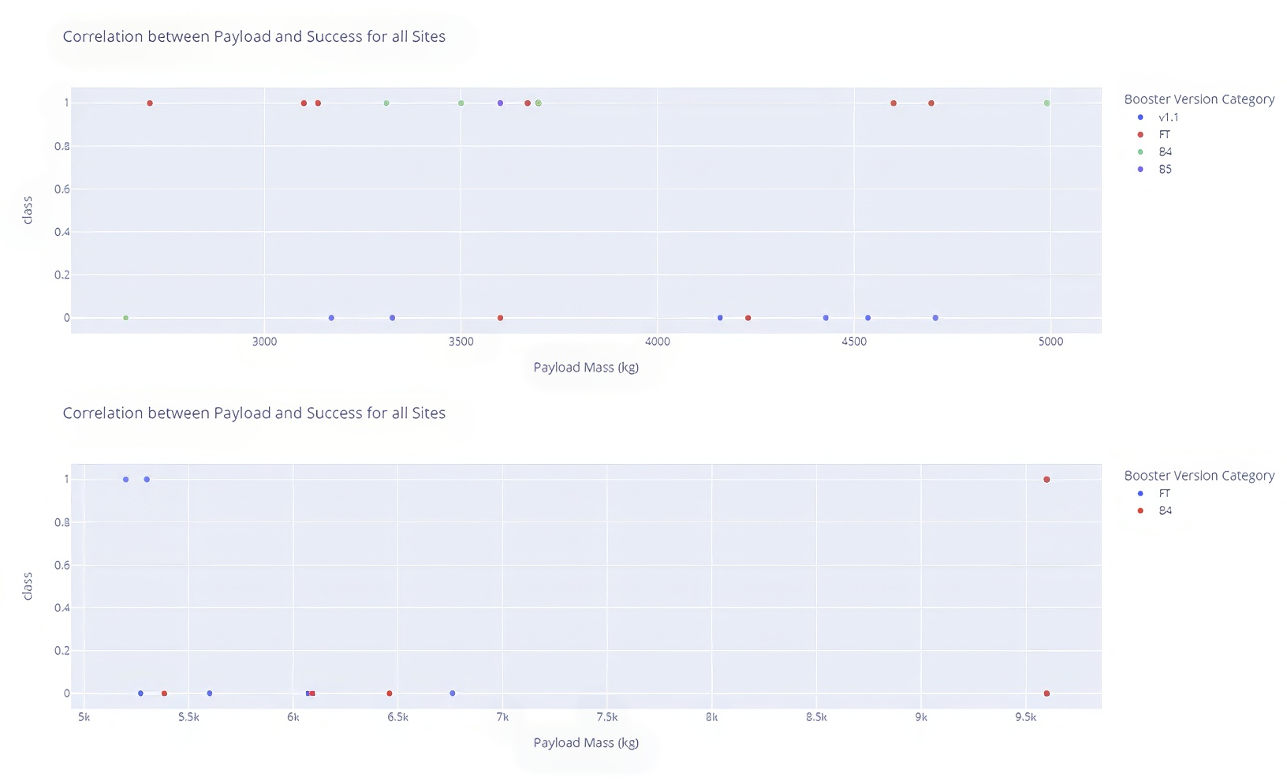
Payload vs. Launch Outcome
Scatter plots examining the correlation between payload mass and mission success for different booster versions across multiple launch sites
Key findings:
There's a mix of successful (class=1) and failed (class=0) missions across different payload masses
No clear correlation is visible between payload mass and mission success
Most failures (class=0) appear to be distributed across different payload masses without a clear pattern
The main conclusion appears to be that payload mass alone is not a strong predictor of mission success, as failures and successes occur across the entire range of payload masses and booster versions.

Slide 42

Section 5

Slide 43
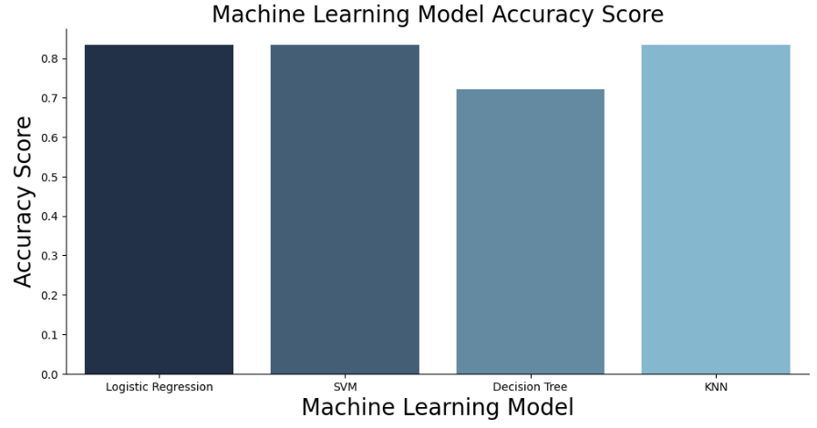
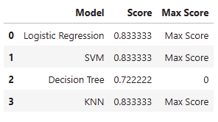
Classification Accuracy
Looking at the bar chart showing accuracy scores for different machine learning models, KNN (K-Nearest Neighbors) appears to have the highest classification accuracy at approximately 0.83 or 83%.
To compare all models:
KNN: ~0.83 (highest)
SVM: ~0.82
Logistic Regression: ~0.82
Decision Tree: ~0.72
The Decision Tree model notably underperforms compared to the other three models, with an accuracy about 10 percentage points lower. KNN leads the pack, though its advantage over SVM and Logistic Regression is relatively small (about 1 percentage point).

Slide 44
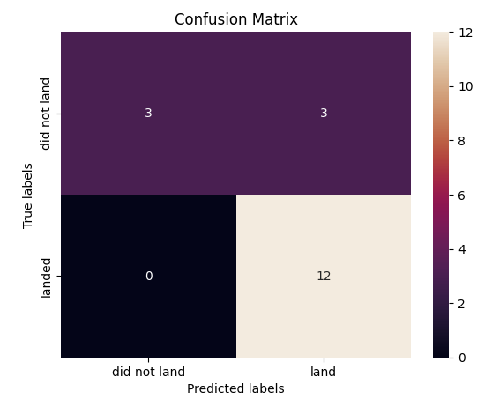
Confusion Matrix
Reading the confusion matrix:
True Negatives (top-left): 3 cases were correctly predicted as "did not land“
False Positives (top-right): 3 cases were incorrectly predicted as "land" when they actually did not land
False Negatives (bottom-left): 0 cases were incorrectly predicted as "did not land" when they actually landed
True Positives (bottom-right): 12 cases were correctly predicted as "land“
Performance Analysis:
The model is quite good at predicting successful landings (12 correct out of 12)
It has some difficulty with unsuccessful landings (3 correct, 3 incorrect)
Total accuracy would be (3 + 12)/(3 + 3 + 0 + 12) = 15/18 ≈ 83.3%
The model shows no false negatives, meaning it never predicts a failure when the landing was actually successful
The main area for improvement would be reducing the false positives, where it predicts success but the landing actually fails
This suggests the model is somewhat optimistic in its predictions, tending to predict successful landings more often than it should.

Slide 45
Conclusions
The success rate for the rocket launches increased after 2013.
Orbits GEO, HEO, ES-L1 and SSO have 100% launch success rate.
Launch site KSC LC-39A has the highest success rate.
The Decision Tree model is the best ML algorithm for analyzing the SpaceX data set and provided the best accuracy results.

Slide 46


